Slide 1
ESP 106 Plotting, Part 1

Slide 2
Graphing and Graphics in R
R has excellent built-in graphing capabilities (“base R”)
There are also dedicated plotting packages that do more fancy or more specialized graphs
We will learn plotting in both base R (this week) and ggplot (next week)
Plotting in Base R has a bit more of a learning curve, but is very flexible
ggplot makes it very easy to do data exploration and quickly make informative plots, but can be more restrictive

Slide 3
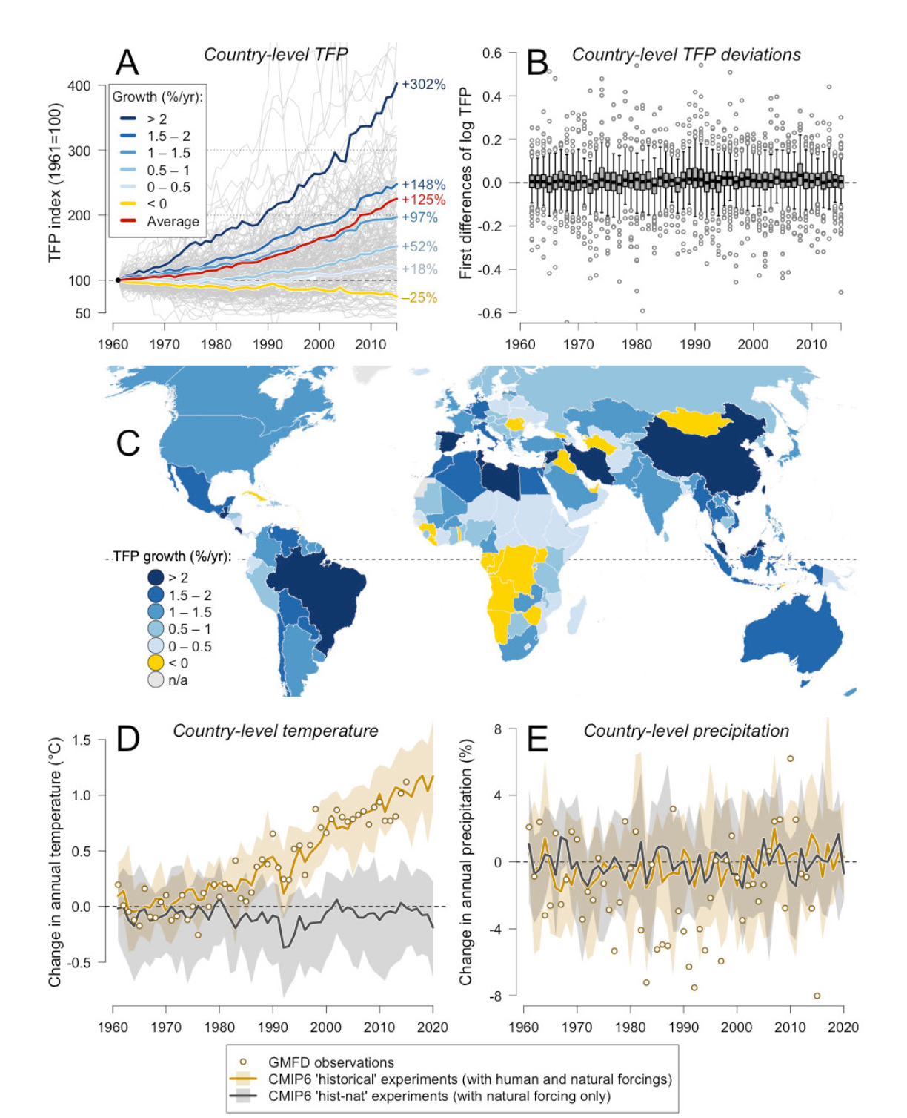
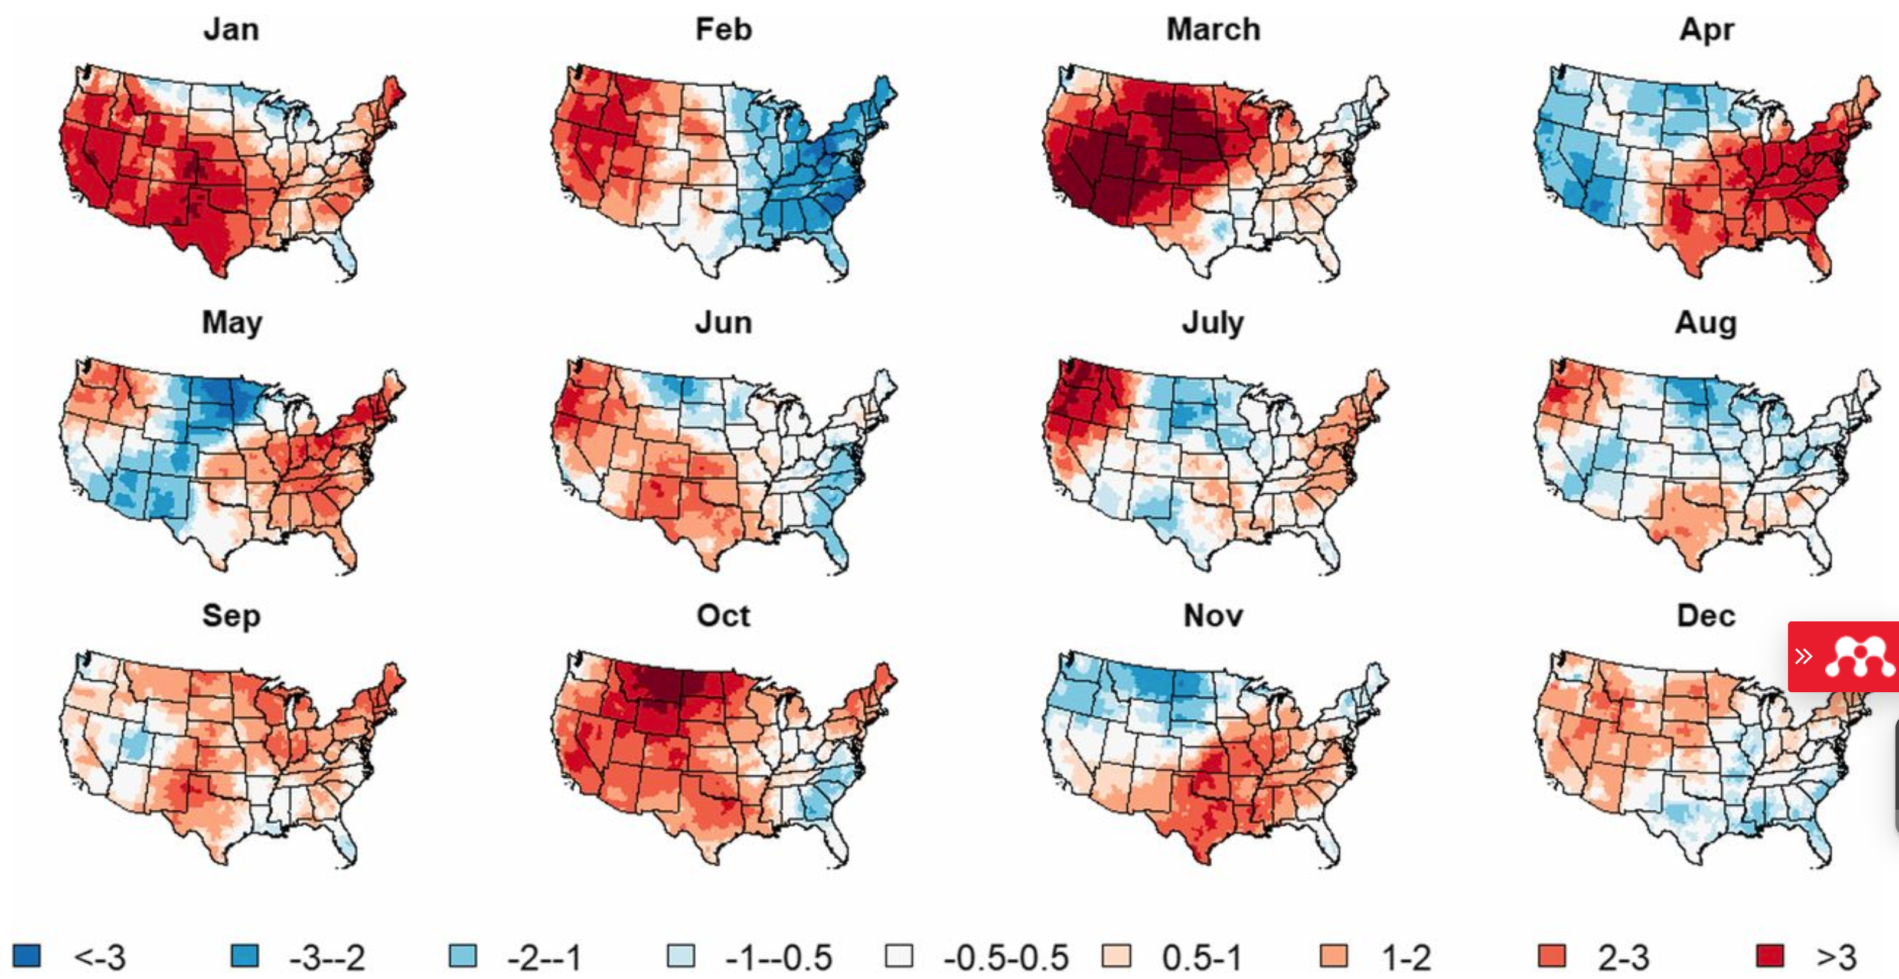
Some cool plots
Maps of spatial and seasonal variation in temperature change (Moore et al, 2017)
Summary graphs of Total Factor Productivity growth in agriculture and temperature and precip changes (Ortiz-Bobea et al. 2020)

Slide 4
plot(x)
Scatter plots of columns in X
X is a data-frame
Basic plotting function is plot()
X is a spatial data object
A map
Many object types in R have plotting methods associated with them.
So if you don’t specify anything else, what you get depends on what kind of object x is

Slide 5
Plotting Relationships Between Two Variables
plot(x, y, type, xlab, ylab ,main)
X-axis data
y-axis data
Type of plot:
“l” – line
“p” – point
X-axis title
y-axis title
Plot title
Other plotting parameters (there are lots! Look at documentation in ?plot):
pch – type of point
cex – point size
lwd – line
xlim, ylim – limits of x and y axes
las – orientation of axis text
Even more characteristics of plotting are controlled using par() – plotting pararameters – check them out using ?par

Slide 6
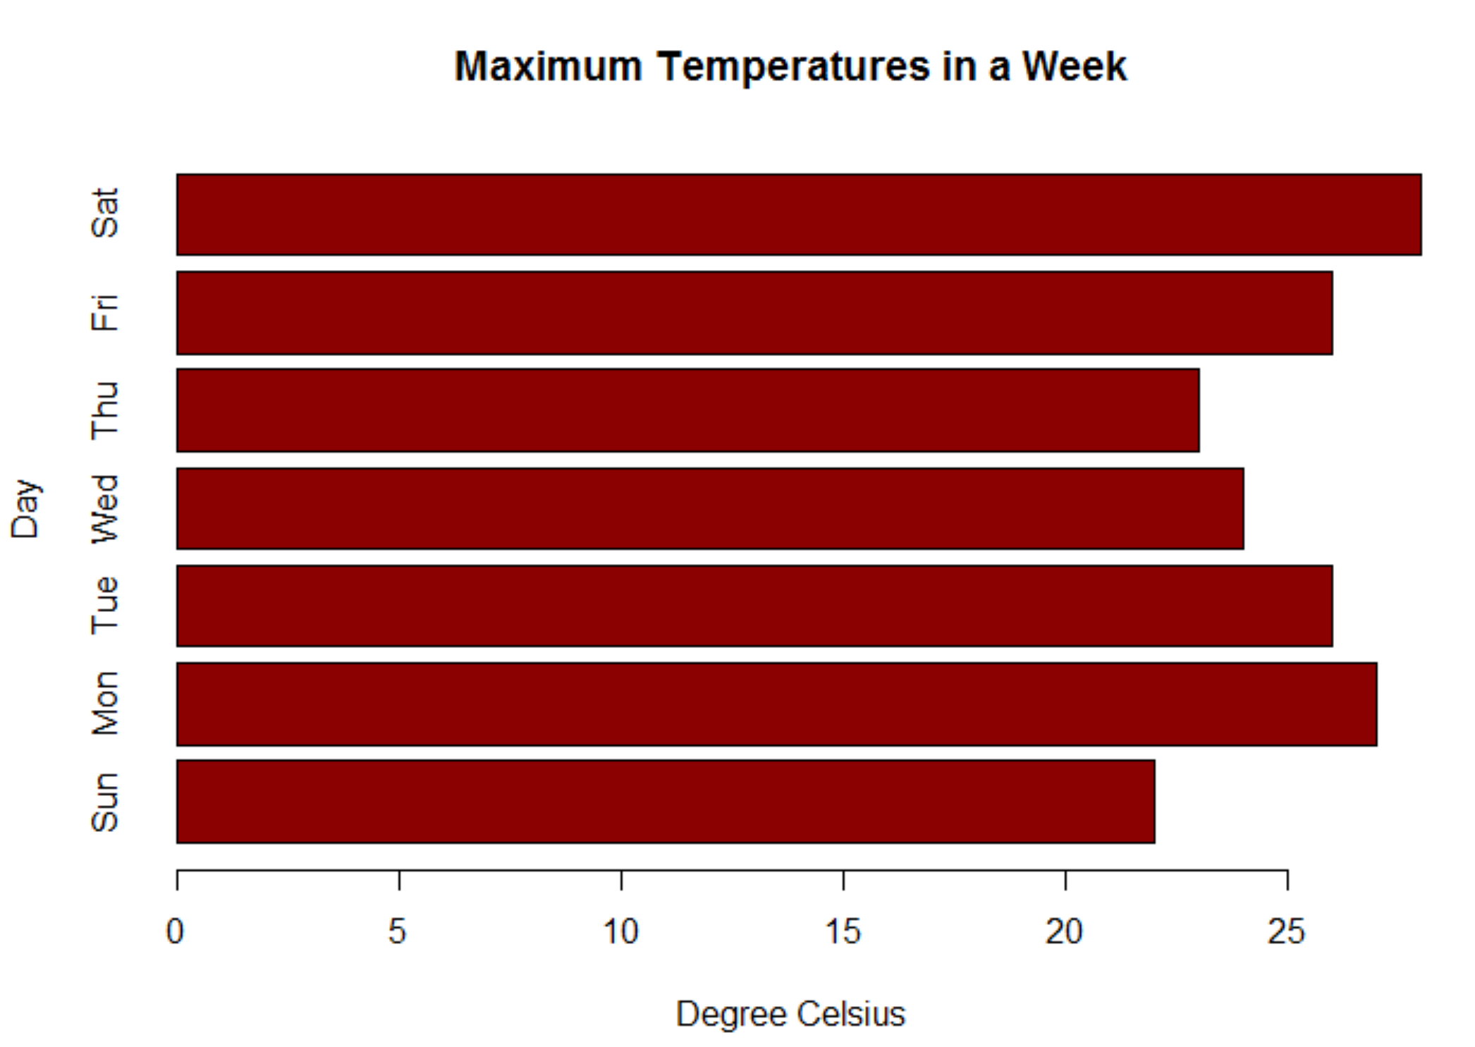
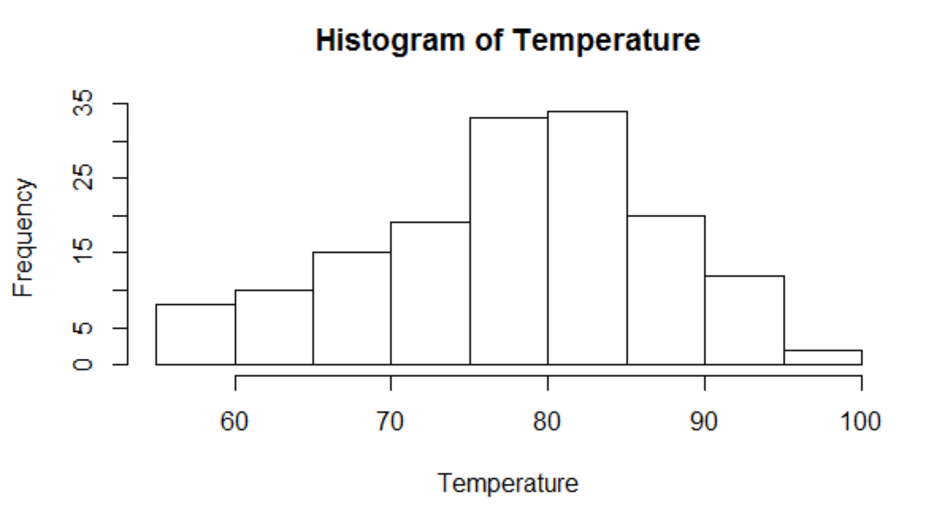
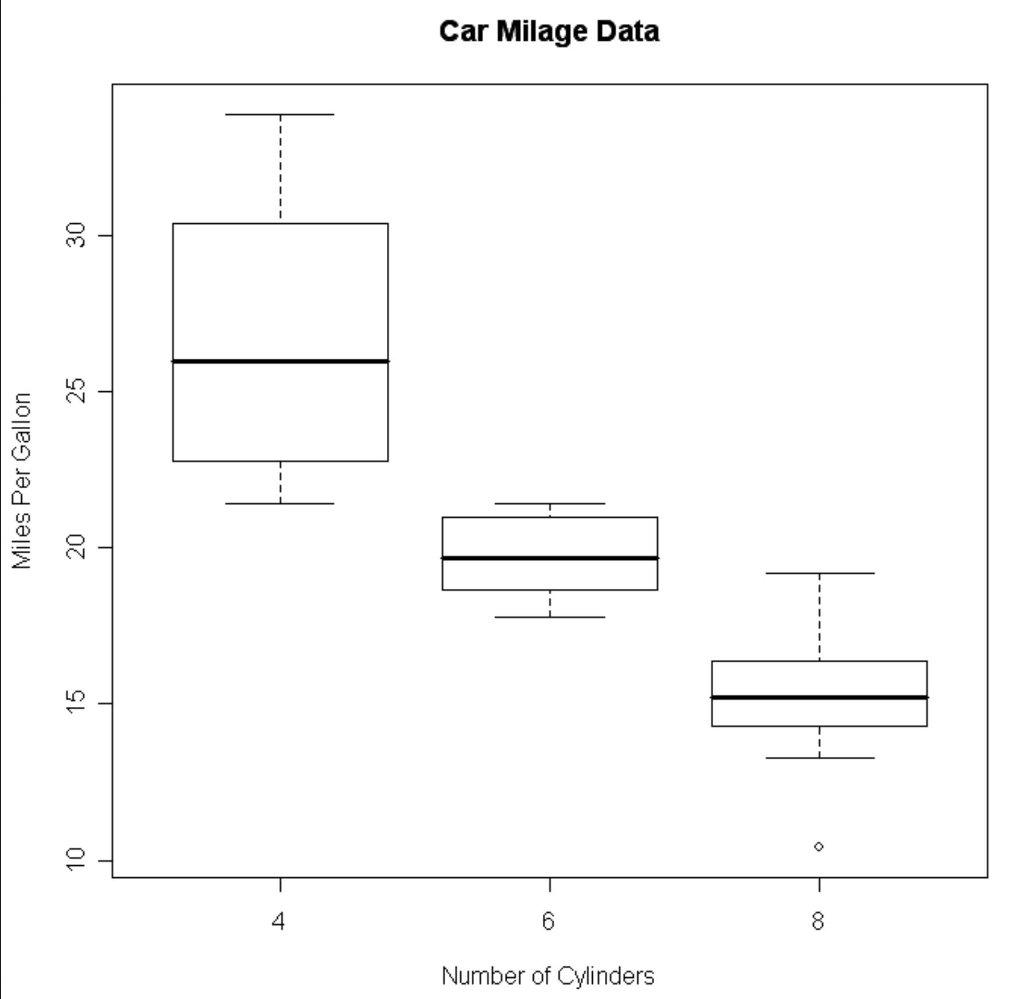
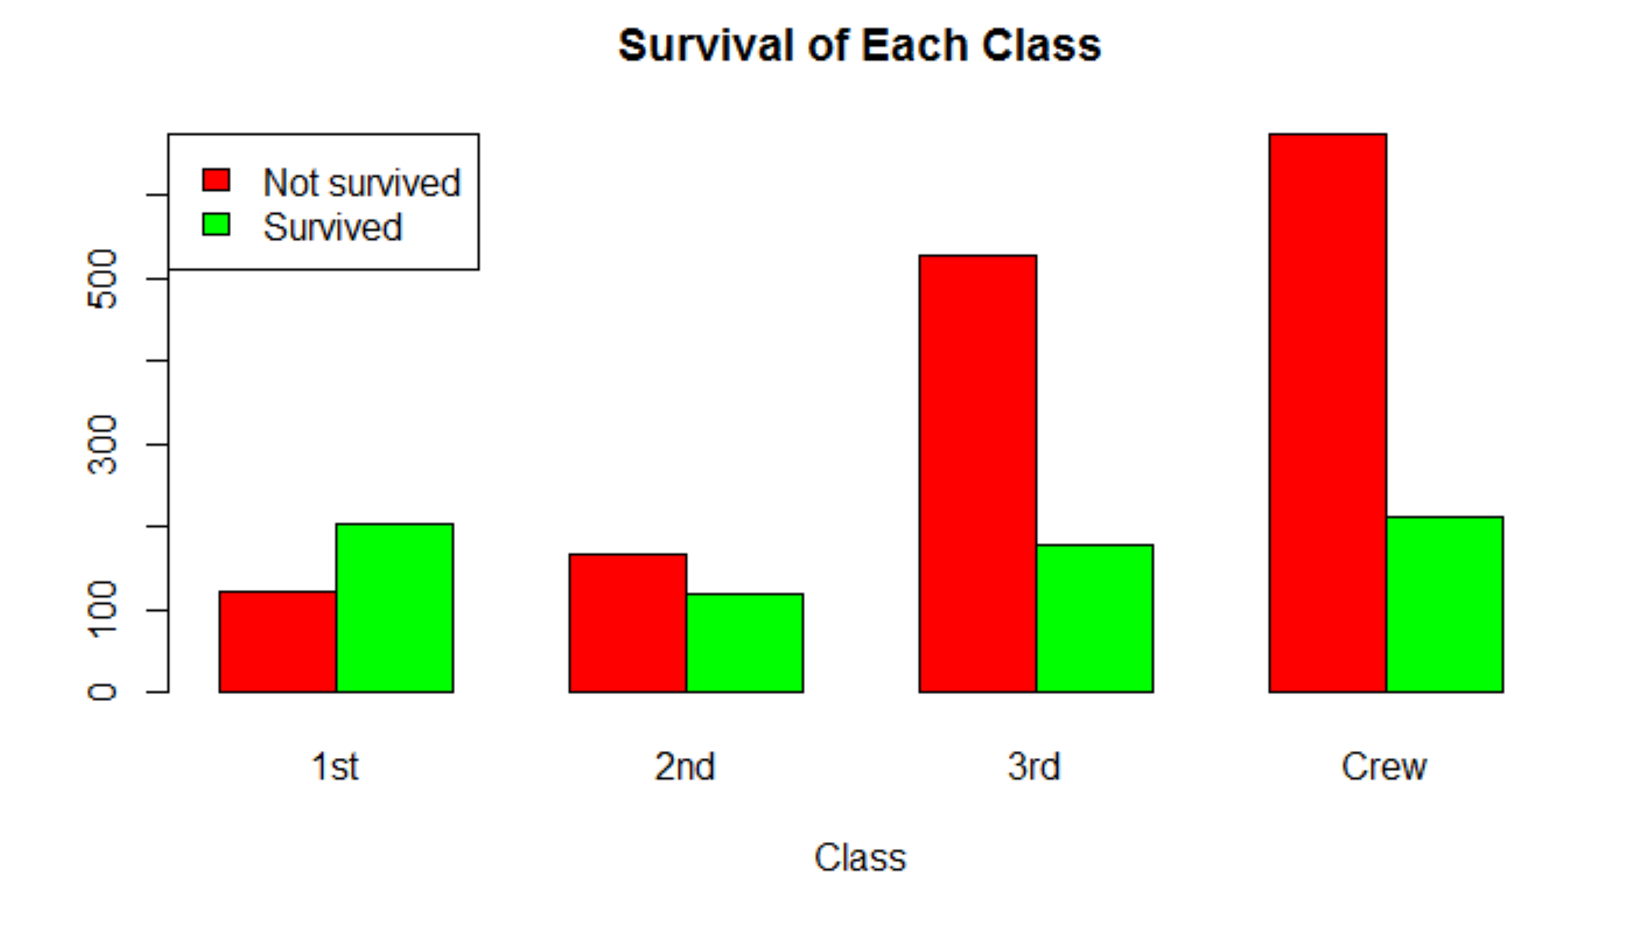
Other types of plots in Base R
Bar Plot
barplot(numeric)
Plot values in a vector as bars
Histogram
hist(numeric)
Plot the distribution of a vector
Box Plot
boxplot(numeric or forumula)
Plot the distribution of a vector, can split by a factor using formula (e.g. mpg~cyl)
Bar Plot
barplot(matrix)
Plot columns of a matrix as bars

Slide 7
Layering Up a Plot Step by Step
par(set general features, e.g. layout, of all subsequent plots)
plot(create plot – this plot will be “active” until another plot is made)
lines(add lines to plot using x,y coordinates)
points(add points to plot using x,y coordinates)
legend(add legend)
axis(add customized axes)
text(add text using x,y coordinates)
mtext(add text to plot margins using x,y coordinates)
title(customize axis titles)
Lots of Options for Customizing Figures!

Slide 8
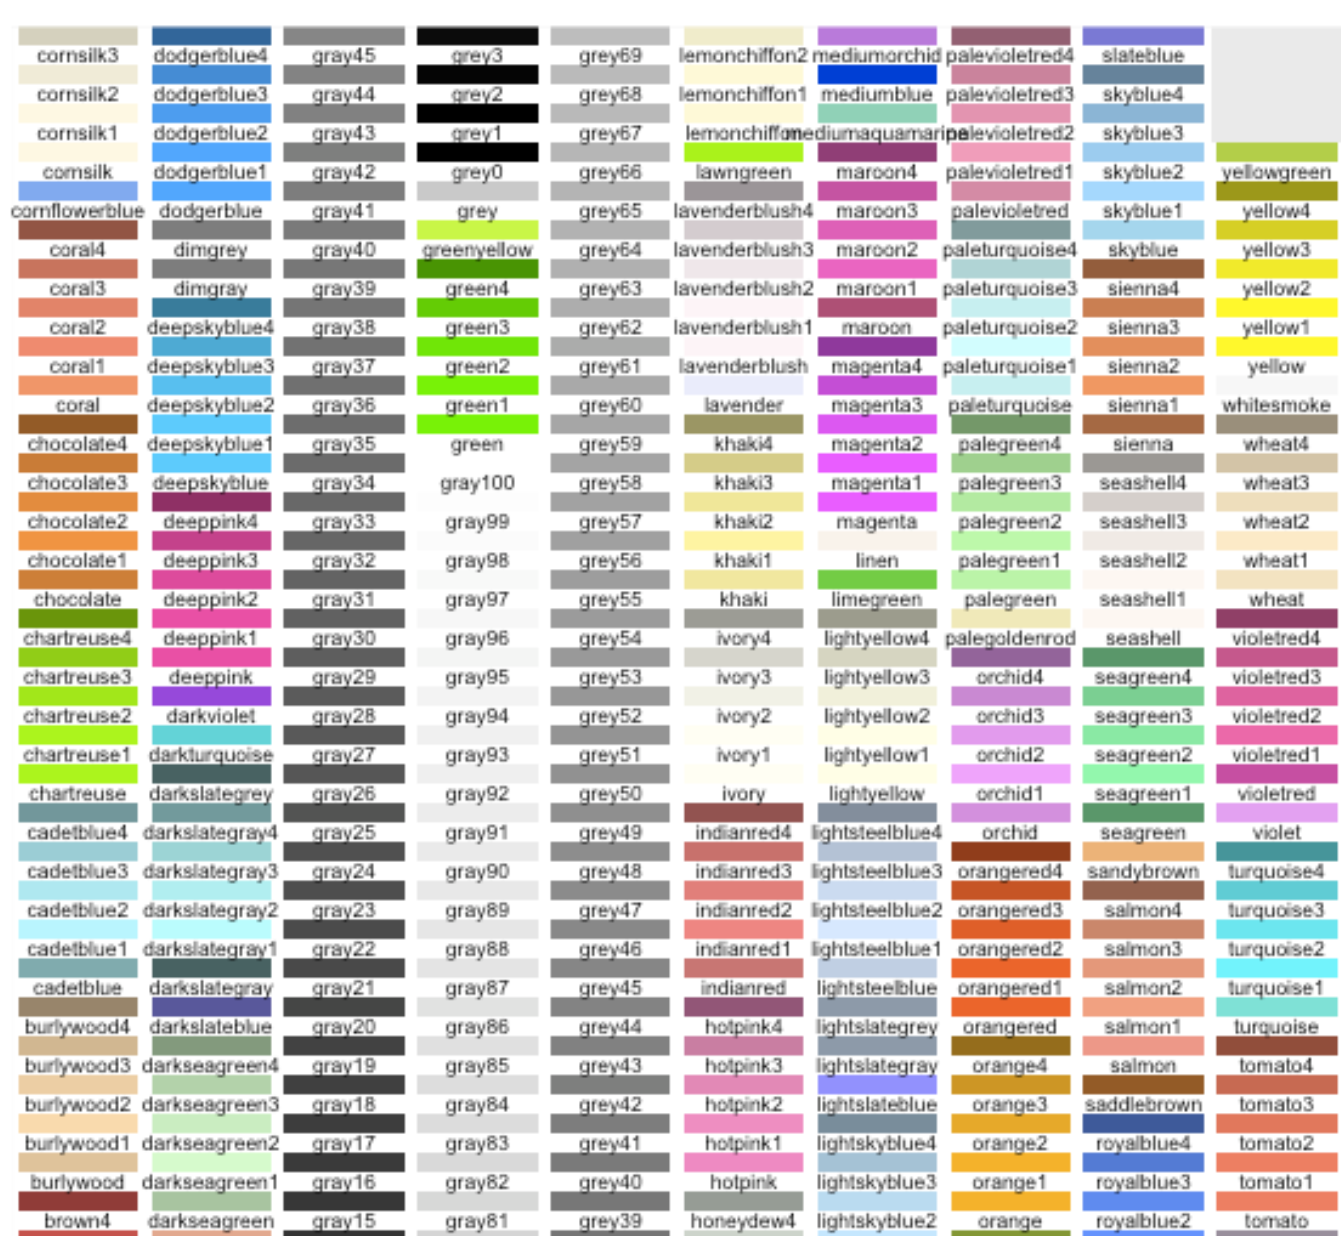
Colors in R
Colors can be represented either with hexadecimal codes (HEX), red green blue values (RGB) or names (often easiest to start with names)
See the names of 657 colors in R by calling colors()
Websites and packages can help create attractive color palettes, for instance, ColorBrewer: https://colorbrewer2.org/
Several useful guides for creating color schemes in R are on the “Useful R Links and Resources” page on Canvas
Color palettes inspired by national park posters: https://github.com/katiejolly/nationalparkcolors
Deep learning for color palettes: http://colormind.io/

Slide 9

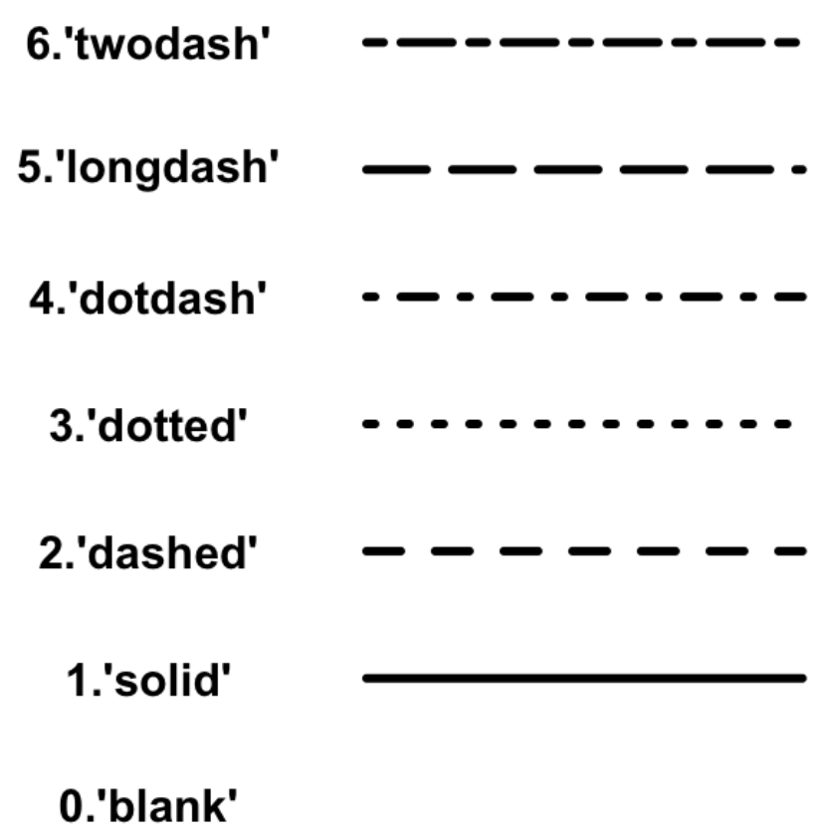
Plotting Characters and Linetypes
Plotting Characters (pch)
Linetypes (lty)

Slide 10
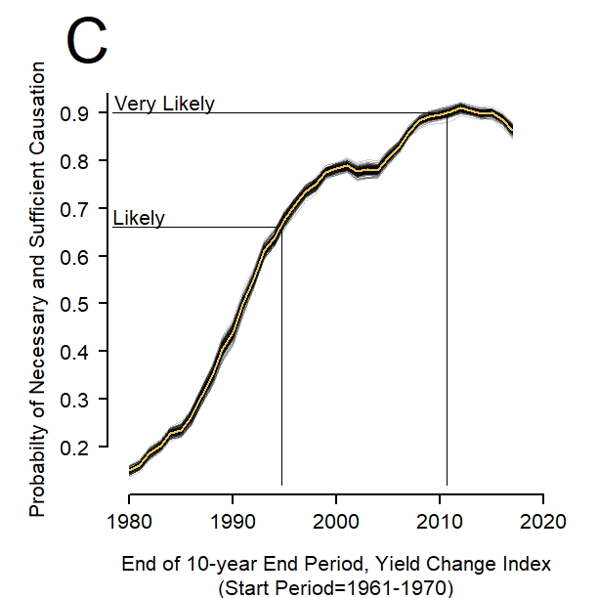

Slide 11
Some examples in R….

Slide 12
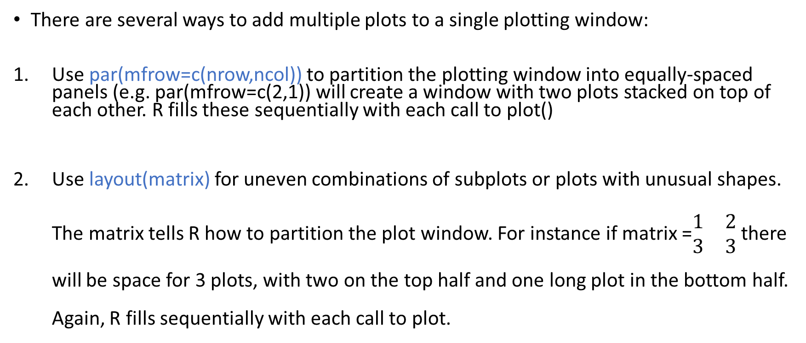
Subplots
There are several ways to add multiple plots to a single plotting window:
Use par(mfrow=c(nrow,ncol)) to partition the plotting window into equally-spaced panels (e.g. par(mfrow=c(2,1)) will create a window with two plots stacked on top of each other. R fills these sequentially with each call to plot()
Use layout(matrix) for uneven combinations of subplots or plots with unusual shapes. The matrix tells R how to partition the plot window. For instance if matrix =$\begin{matrix}1 & 2 \\ 3 & 3\end{matrix}$ there will be space for 3 plots, with two on the top half and one long plot in the bottom half. Again, R fills sequentially with each call to plot.

Slide 13
Intro to Lab 3
Data taken from Our World in Data: https://ourworldindata.org/
Two files:
airpollution.csv
gdppercapandgini.csv
Steps
Read in air pollution file
Make one plot with indoor and outdoor air pollution death rates for two countries you are interested in
Read in the economic data file and merge with air pollution
Make a two panel plot showing indoor and outdoor air pollution death rates (y axis) against GDP per capita (x axis)

Slide 14
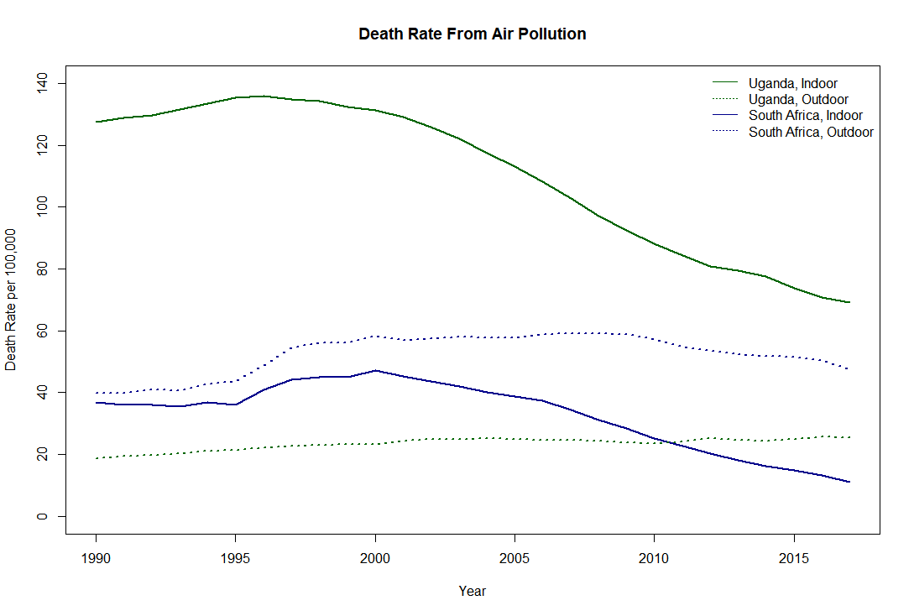
Plot 1 – Uganda and South Africa as Examples

Slide 15
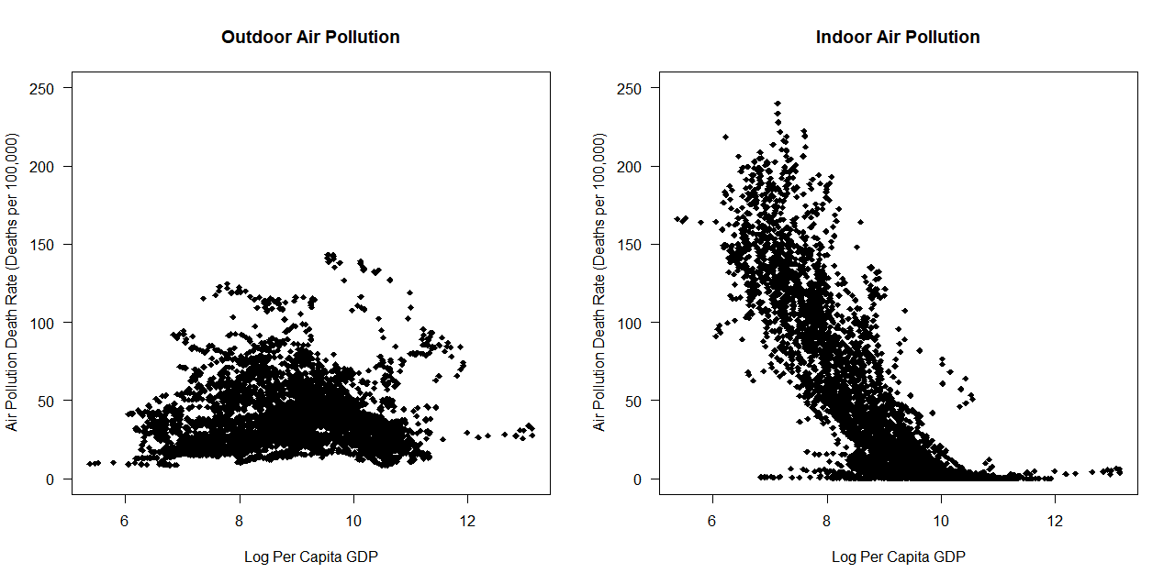
Plot 2

Slide 16
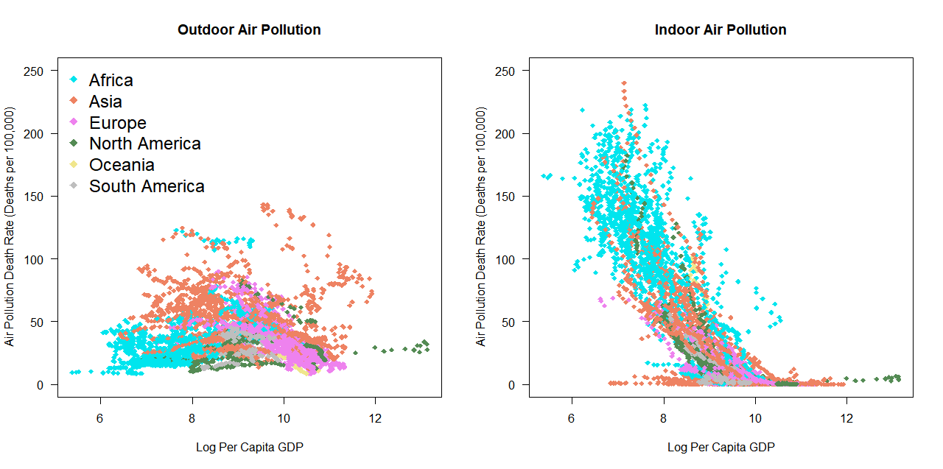
Plot 2 – Stretch Goal – Color by Continent

Slide 17
Some Useful Functions
read.csv(filepath) – read in data from a .csv file
colnames(dataframe)=c(“name1”, “name2”….) – change the column names of a data frame
unique(dataframe$column) – get all unique values in that column (e.g. country names)
dataframe[which(condition),] – subset a data frame to only rows that meet a true-false condition
merge(dataframe1,dataframe2) – merge 2 data frames together

Slide 18
Merging Two Data Frames
Data frame 2
Student | Grade | Class
Bobby | B- | Sophomore
Carlos | A | Junior
Terry | A- | Junior
Student | School
Bobby | Davis
Terry | Irvine
Ursula | Berkeley
Carlos | Davis
Inga | Davis
Data frame 1
We want to combine data into one data frame that contains school, grade, and class information for each student but:
Order of students is not the same between the two data frames
Data frame 2 contains some students that aren’t included in Data frame 1
Time for a merge!

Slide 19
merge(df1, df2, by, all)
Names of 1 or more columns with ID variables that define unique observations
How to deal with observations missing in one of the data frames?
By default R only keeps observations that appear in both data frames
Change using all=TRUE or all.x=TRUE or all.y=TRUE
Two data frames you want to merge together into one

Slide 20
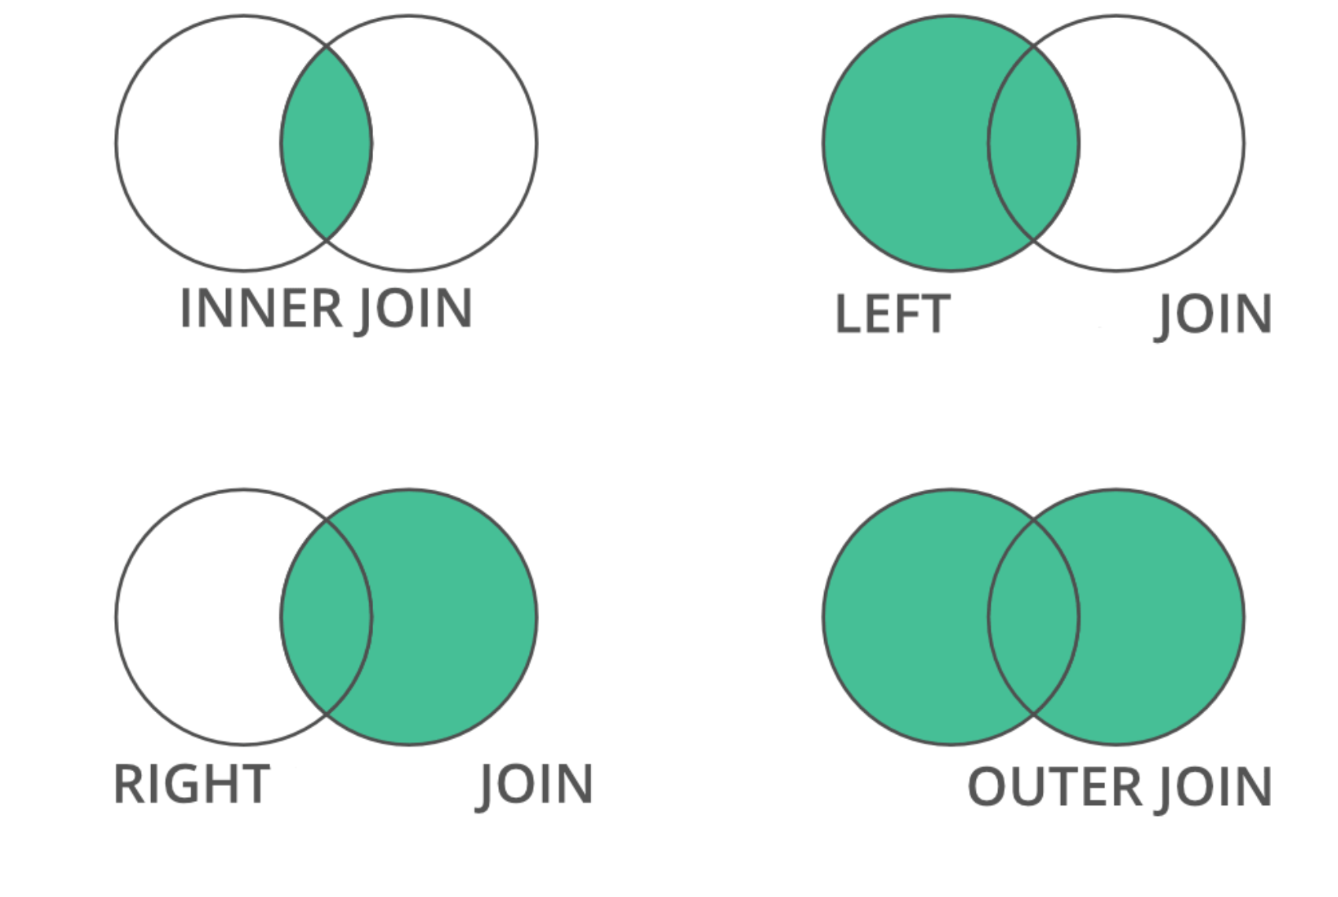
all=FALSE
all.x=TRUE, all.y=FALSE
all.x=FALSE, all.y=TRUE
all=TRUE

